Slide 1

InstaCart Customer Insights: Behavior and Clusters Addi Wei 706-386-6054

Slide 2
Topics
Objectives: Know Your Customer
Data Collection / Dataframe Study
Best Selling Products & Departments
Best Customers
Clustering – Feature Engineering
Word2Vec / Word Embeddings
Customer Clusters
Conclusion / Next Steps

Slide 3
Objectives: Know your customer
What are the top selling products?
Which Departments are doing best?
Who are the top 30 customers?
When are they buying (days of the week, hours of the day
Ordering Frequency
How can we cluster customers to optimize our marketing strategy?
Customer Buying Behavior
Customer Clusters

Slide 4
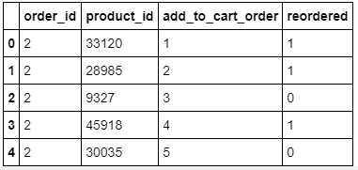
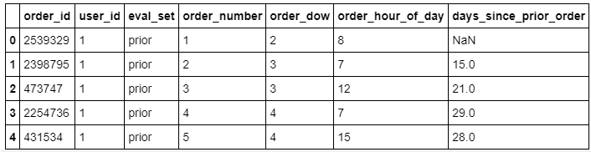
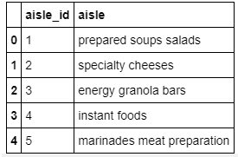
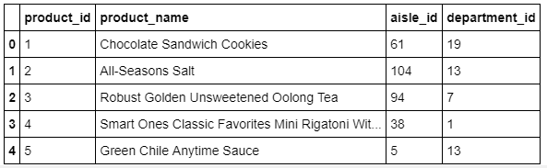
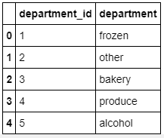
Data Collection / Dataframe Study
Orders
Prior Orders
Previous orders and orders are tied by order_id
Products

Slide 5
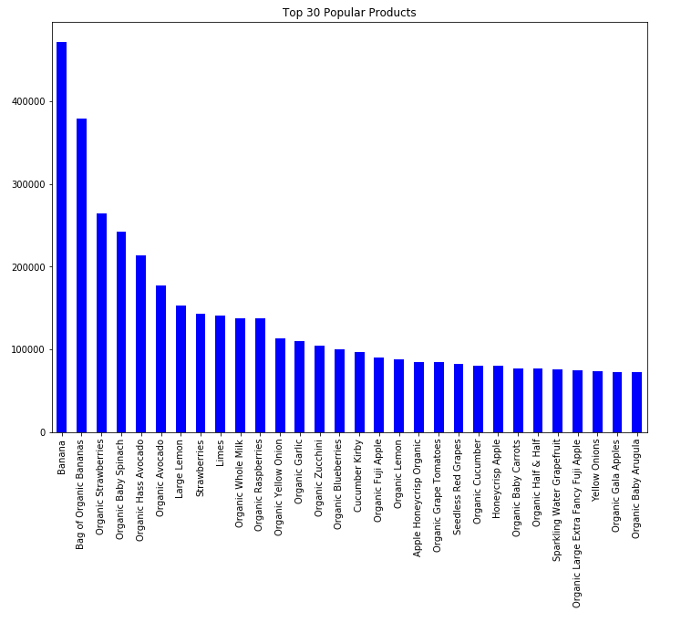
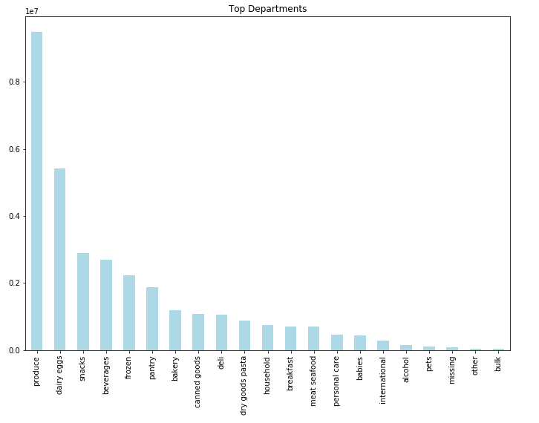
Top Selling Products & Departments

Slide 6

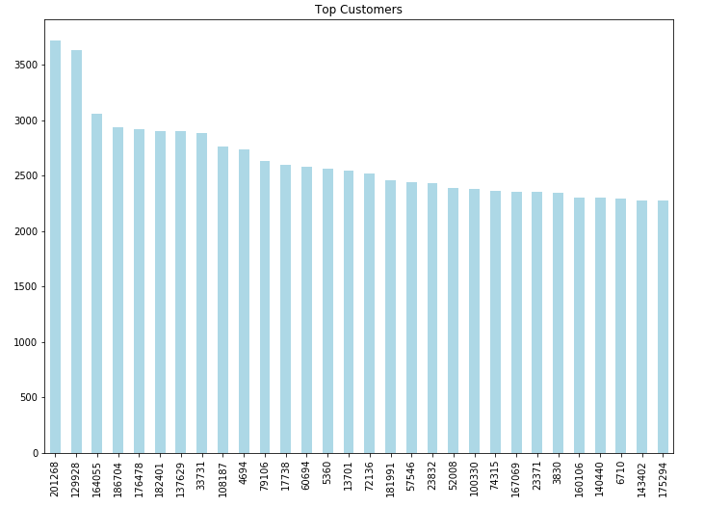
Best Customers
Marketing / Promotional Activity for these Top 30 customers

Slide 7
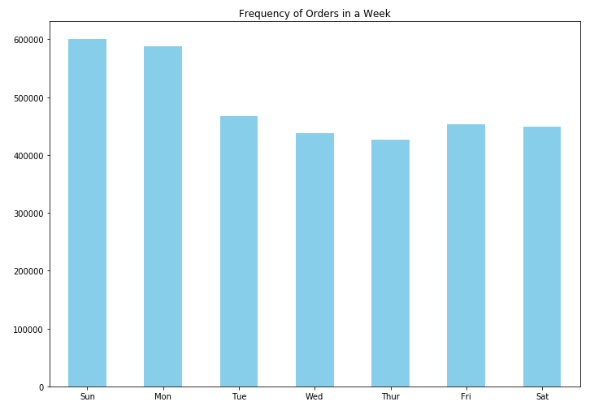
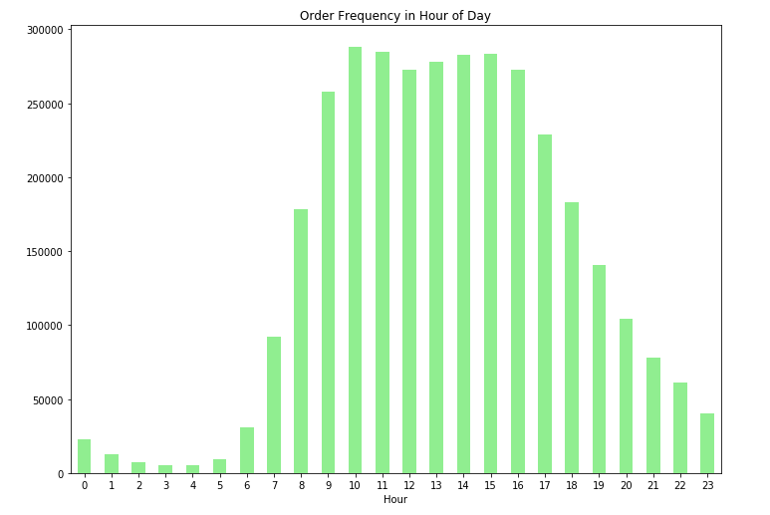
When are Customers Buying?
A lot of sales on Sunday and Monday – families are restocking for the week
Predominately selling during the business hours in daytime

Slide 8
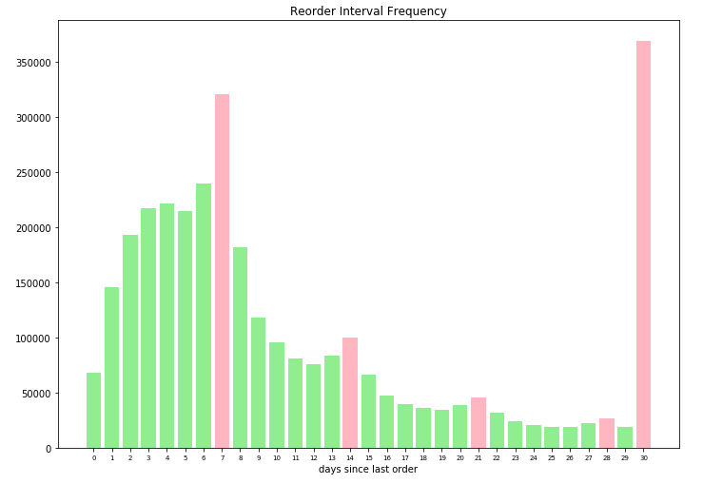
Order Frequency
Weekly Ordering Pattern Observed
Spike at 30 – this could be a bucketized amount (meaning 30 captures all values > 30)

Slide 9
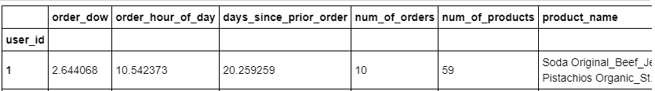
Clustering
Feature Engineering of Users
Average utilized for day of week, order hour of day, days since prior order
Utilize Word2Vec to deal with product name / unstructured data

Slide 10
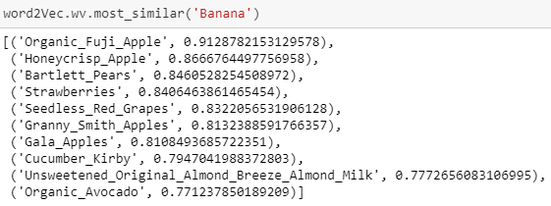
Word2Vec – cont’ed
W2V did a good job training model – relationships with close words ‘Banana’

Slide 11
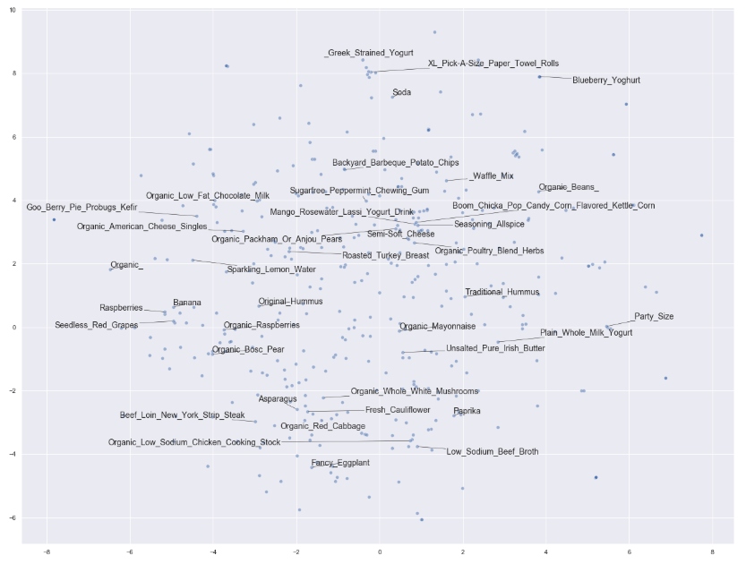
Word2Vec – cont’ed
Relationships among butter, yogurt, mayonise
Fruits over here

Slide 12
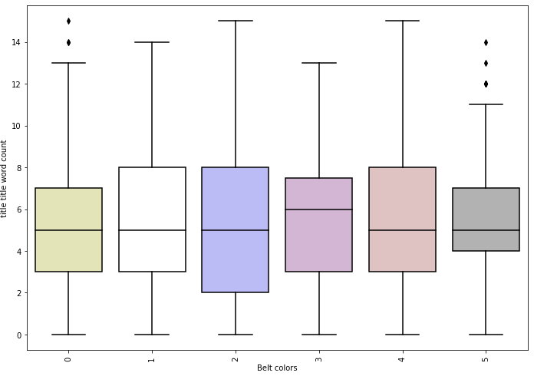
Text EDA (Example of discarded feature)
Count of words in title that have uppercase first letter

Slide 13
Count and Density Based Feature Summary
Count Based Features of Text Data | Brief Description | Notes:
title_char_count | # of characters in title | black belts have fewer chars
title_word_count | # of words in title | black belt videos have fewer words
title_word_density | character count / word count + 1 | Disregard
title_punctuation_count | # of punctuations in title | black belt videos have punctuations
title_title_word_count | # of words that have first letter capitalized | Disregard
title_upper_case_word_count | # of words that are completely capitilized | Upside down parabola
title_stopwords_count | # of stop words in title | black belt video titles have lowest stop word avg
desc_char_count | # of characters in description | black belt videos have highest description char count avg
desc_word_count | # of words in description | black belt videos have highest description word count avg and no outliers
desc_word_density | character count / word count + 1 | black belt videos have smallest range
desc_punctuation_count | # of punctuations in title | black belt videos have highest punctuation count
desc_title_word_count | # of words that have first letter capitalized | black belt videos have highest average words for first letter capitalized in desc
desc_upper_case_word_count | # of words that are completely capitilized | black belt videos have fewer completely upper case description words
desc_stopwords_count | # of stop words in description | black belt videos have MORE stop words on average inside description
tags_char_count | # of characters in tags | black belt videos have higher average for character tags count
tags_word_count | # of words in tags | black belt videos have higher average for # of words
tags_word_density | character count / word count + 1 | black belt videos have slightly higher word density average with a smaller range
tags_punctuation_count | # of punctuations in tags | black belt videos have slightly higher average for punctuation count in tags
tags_title_word_count | # of words that have first letter capitalized | Disregard
tags_upper_case_word_count | # of words that are completely capitilized | black belt videos have fewer completely upper case tags
tags_stopwords_count | # of stop words in tags | Upside down parabola

Slide 14
Text Modeling Results
NLP Features | Model | Notes | Accuracy
Train W2V Scratch, MeanEmbeddingVectorizer, unstemmed | Log Reg |  | 0.303
BoW TFIDF | Random Forest( n_estimators=100, max_depth=5 |  | 0.3131
Train W2V Scratch, TFIDFEmbeddingVectorizer, unstemmed | Log Reg |  | 0.3131
1-2 gram, TFIDF, stemmed, stop words | XGboost |  | 0.3232
Count and Density Based | Log Reg (C=1) |  | 0.3333
BoW, TFIDF | MNB |  | 0.3333
BoW, TFIDF | Stochastic Gradient Descent (loss='hinge', penalty='l2', alpha=1e-3, n_iter=5) | tested w/ n_iter, alpha, no changes | 0.3333
BoW, TFIDF | KNN (nn range 1-20) | no change based on nn | 0.3434
1-2, gram TFIDF, stop words | MNB |  | 0.3535
1-2 gram, TFIDF, stemmed, stop words | Log Reg |  | 0.3737
1-2 gram, TFIDF, stop words | XGBoost |  | 0.3737
BoW, TFIDF | XGBoost (objective ='multi:softmax', colsample_bytree = 0.3, learning_rate = 0.1, max_depth = 5, alpha = 10, n_estimators = 10) |  | 0.3838
1-2 gram, TFIDF, stemmed, stop words | XGBoost |  | 0.3838
BoW TFIDF | Random Forest - random search | {'n_estimators': [200, 400, 600, 800, 1000, 1200, 1400, 1600, 1800, 2000], 'max_features': ['auto', 'sqrt'], 'max_depth': [10, 20, 30, 40, 50, 60, 70, 80, 90, 100, 110, None], 'min_samples_split': [2, 5, 10], 'min_samples_leaf': [1, 2, 4], 'bootstrap': [True, False]} | 0.3992
BoW, TFIDF | Log Reg |  | 0.404
BoW, CountVectorizer | Log Reg | Same results as TFIDF because TFIDF is weighted with Log(N/n) | 0.404
1-2 gram TFIDF, stop words | Log Reg |  | 0.404
1-2 gram, TFIDF, stemmed, stop words | Log Reg |  | 0.404
1-2 gram, TFIDF, stemmed, stop words | Random Forest |  | 0.4242

Slide 15
Final Model: Numeric + Text Data
NLP Features | Model | Notes / Parameters | Accuracy | Average Weighted F1 Score
Count features, BoW, CountVectorizer | OneVsrest(Log Reg) |  | 0.4678 | 0.4386
Count features, BoW, CountVectorizer | Random Forest |  | 0.4355 | 0.38621
Count features, BoW TFIDF | Stochastic Gradient Descent (loss='hinge', penalty='l2', alpha=1e-3, n_iter=5, ) |  | 0.2621 | 0.1958
Count features, BoW TFIDFVectorizer | Random Forest - Default |  | 0.4516 | 0.4018
Count features, BoW TfidfVectorizer(1-2 gram, stop words) | KNN (nn =11) |  | 0.5323 | 0.5234
Count features, BoW TfidfVectorizer(1-2 gram, stop words) | XGBoost(objective ='multi:softmax', colsample_bytree = 0.3, learning_rate = 0.1, max_depth = 5, alpha = 10, n_estimators = 10) |  | 0.7581 | 0.7711
Count features, BoW TfidfVectorizer | XGBoost(learning_rate =0.1, n_estimators=1000, max_depth=5, min_child_weight=1, gamma=0, subsample=0.8, colsample_bytree=0.8, objective= 'binary:logistic', nthread=4, scale_pos_weight=1,seed=27) | increasing number of estimators to 1000 helped | 0.8145 | 0.8146
Count features, BoW TfidfVectorizer(1-2 gram, stop words) | XGBoost Grid Search Tuned params | Grid Search ((xgb__max_depth': 3, 'xgb__min_child_weight': 1)) | 0.8064 | 0.806
Count features, BoW TfidfVectorizer(1-2 gram, stop words) | Gradient Boosting Classifier | Random Search (n_estimators = [100, 500, 900, 1100, 1500] max_depth = [2, 3, 5, 10, 15] min_samples_leaf = [1, 2, 4, 6, 8] min_samples_split = [2, 4, 6, 10] max_features = ['auto', 'sqrt', 'log2', None]) | 0.8387 | 0.8417
Count features, BoW TfidfVectorizer(1-2 gram, stop words) | Gradient Boosting (default) |  | 0.8548 | 0.8596

Slide 16
Conclusion / Next Steps
Obtain additional data from our customers if possible (sex, age, location)
Improve unstructured data process / clean up
Predictions: Feature engineering on products, users, products + users to predict purchased product
Models: Random Forest, Xgboost, Neural network
Model Selection Criteria:
1) Training Efficiency
2) High Accuracy
Tune hyperparameters to optimize model:
1) Cross validation

